Slide 1
Lecture 7
Ch. 9: Subprograms
Ch. 10: Implementing Subprograms (brief coverage)

Slide 2
Topics
Introduction
Fundamentals of Subprograms
Design Issues for Subprograms
Local Referencing Environments
Parameter-Passing Methods
Semantic Modes
Conceptual Models
Implementations
Subprograms as Parameters
Overloaded Subprograms
Generic Subprograms
User-Defined Overloaded Operators

Slide 3
Introduction
Two fundamental abstraction facilities
Process abstraction
Emphasized from early days
Subprograms -- Discussed in this Lecture
Data abstraction
Emphasized since 1980s
ADTs -- Discussed at length in Lecture 11

Slide 4
Process Abstraction -- Illustration
main () { display(int x) {
int a, b, c, d; print(x);
print(a); print(“___”);
print(“___”); print(“****”);
print(“****”); }
print(b); main() {
print(“___”); int a, b, c, d;
print(“****”); display(a);
… display(b);
} display(c);
display(d);
}

Slide 5
Fundamentals of Subprograms
Each subprogram has a single entry point
The calling program is suspended during execution of the called subprogram
Control always returns to the caller when the called subprogram’s execution terminates
Unless exception occurs
See illustration next slide

Slide 6
Geeksforgeeks.org

Slide 7
Run-time stack
(top)
main
(top)
f_a
main
(top)
f_b
f_a
main
(top)
f_c
f_b
f_a
main
main calls f_a()
f_a calls f_b()
f_b calls f_c()
(top)
f_b
f_a
main
(top)
f_a
main
(top)
main
f_c returns
f_b returns
f_a returns

Slide 8
Basic Definitions
A subprogram definition describes the interface to and the actions of the subprogram abstraction
In Python, function definitions are executable; in all other languages, they are non-executable
In Ruby, function definitions can appear either in or outside of class definitions. If outside, they are methods of Object. They can be called without an object, like a function
In Lua, all functions are anonymous
A subprogram call is an explicit request that the subprogram be executed
A subprogram header is the first part of the definition, including the name, the kind of subprogram, and the formal parameters
The parameter profile (aka signature) of a subprogram is the number, order, and types of its parameters
The protocol is a subprogram’s parameter profile and, if it is a function, its return type

Slide 9
Basic Definitions (continued)
A subprogram declaration provides the protocol, but not the body, of the subprogram
Function declarations in C and C++ are often called prototypes
A formal parameter is a dummy variable listed in the subprogram header and used in the subprogram
An actual parameter represents a value or address used in the subprogram call statement

Slide 10
Parameters and Arguments
void display (int x, double y) { … return; }
int main () {
int count; double sum;
display(count, sum); …
}
By position (in the above call)
count -> x sum -> y
By name/keyword:
display (sum => y, count => x); //Ada-like

Slide 11
Parameters: Default Values and Variable Length
In certain languages ( C++, Python, etc.), formal parameters can have default values (if no actual parameter is passed)
In C++, default parameters must appear last because parameters are positionally associated (no keyword parameters)
Variable length argument
A feature that allows a function to receive any number of arguments, e.g. in the situations for a function to handle variable number of arguments according to requirement such as
1) Sum of given numbers. 2) Minimum of given numbers.
C++, Java, Python etc. support this feature

Slide 12
Example: default (parameter) values
int cost(int items, double taxRate = 9.0, int base = 0) {
return items * (1+taxRate) + base;
}
cout << cost(4);
cout << cost(4, 10.0);
cout << cost (4, 8.0, 1);

Slide 13
Variable Length Arguments: Examples
//C# code segment
static int Multiply(params int[] b) {
int mul =1;
foreach (int a in b) { mul = mul*a; }
return mul;
}
//function call accepts zero or more arguments
int mulVal1 = Multiply(5);
int mulVal2 = Multiply(2, 3, 10);
Discussion Questions:
How Java (Java’s syntax) supports variable length arguments?
Java vs. C# in support of variable length arguments?

Slide 14
Procedures and Functions
There are two categories of subprograms
Procedures are collection of statements that define parameterized computations
Procedure doesn’t return a value
Functions structurally resemble procedures but are semantically modeled on mathematical functions – a return value is expected.
Functions are expected to produce no side effects
In practice, program functions have side effects

Slide 15
Design Issues for Subprograms
Local variables: static or dynamic variables?
Scope, referencing environment?
Can subprogram definitions be nested?
i.e. can subprogram definitions appear in other subprogram definitions?
What parameter passing methods are provided?
Are parameter types checked?
If subprograms can be passed as parameters and subprograms can be nested, what is the referencing environment of a passed subprogram?
Are functional side effects allowed?
What types of values can be returned from functions?
How many values can be returned from functions?

Slide 16
Local Referencing Environments
Local variables can be stack-dynamic
- Advantages
Support for recursion
Storage for locals is shared among some subprograms
Disadvantages
Allocation/de-allocation, initialization time
Indirect addressing
Subprograms cannot be history sensitive
In most contemporary languages, locals are stack dynamic
e.g in Java, C++, Python methods
Local variables can be static
Advantages and disadvantages are the opposite of those for stack-dynamic local variables
In C-based languages, locals are by default stack dynamic, but can be declared static

Slide 17
stack space
heap space
Figure source: it.uu.se

Slide 18
Run-time stack: Local variables
(top)
f_a d: int str: reference
main d: double
(top)
main d: double
(top)
main d: double
main calls f_a()
f_a() returns

Slide 19
Subprogram Basics: Summary
A subprogram definition describes the actions represented by the subprogram
Subprograms can be either functions or procedures
Local variables in subprograms can be stack-dynamic or static
Parameters can be bound by position or keywords
Some languages allow default parameters and/or variable length parameters
Next lecture will discuss more about parameter passing

Slide 20
Parameter Passing
Parameter passing is the mechanism used to pass arguments (actual parameters) to parameters (formal parameters, i.e. dummy variables) defined a procedure (subroutine) or function.
The most common methods are to pass the value of the actual parameter (call by value), or to pass the address of the memory location where the actual parameter is stored (call by reference).

Slide 21
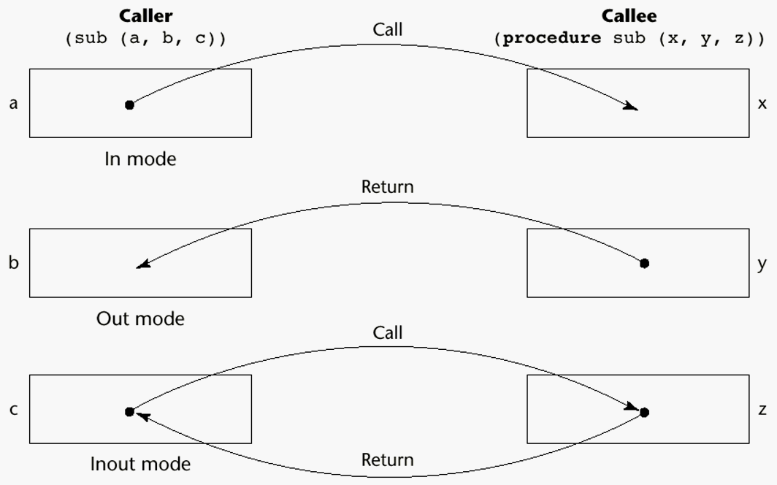
Semantic Models of Parameter Passing
In mode
Out mode
Inout mode

Slide 22
Example: Parameter Passing modes
void modeDemo (int item, int & count, double & cost) {. //C++
cost = item * count * 1.3;
count ++;
return;
}
int unit = 5; double total; int amount = 8;
modeDemo (unit, amount, total);
Theoretically: unit -> item (in); amount <-> count (in out);
total <- cost (out)
C# (not C++) clearly indicates the out mode.

Slide 23
Conceptual Models of Transfer
Arguments (actual parameters) are passed to formal parameters in either of the following ways:
Physically move a value
Move an access path to a value
Practically we have to the following models
Pass by value
Pass by result
Pass by value-result
Pass by reference
Pass by name
Trends of parameter passing:
5 models => 2 models (by value & reference)
=> 1 model (pass by value)
New model: Pass by assignment (Python etc.)

Slide 24
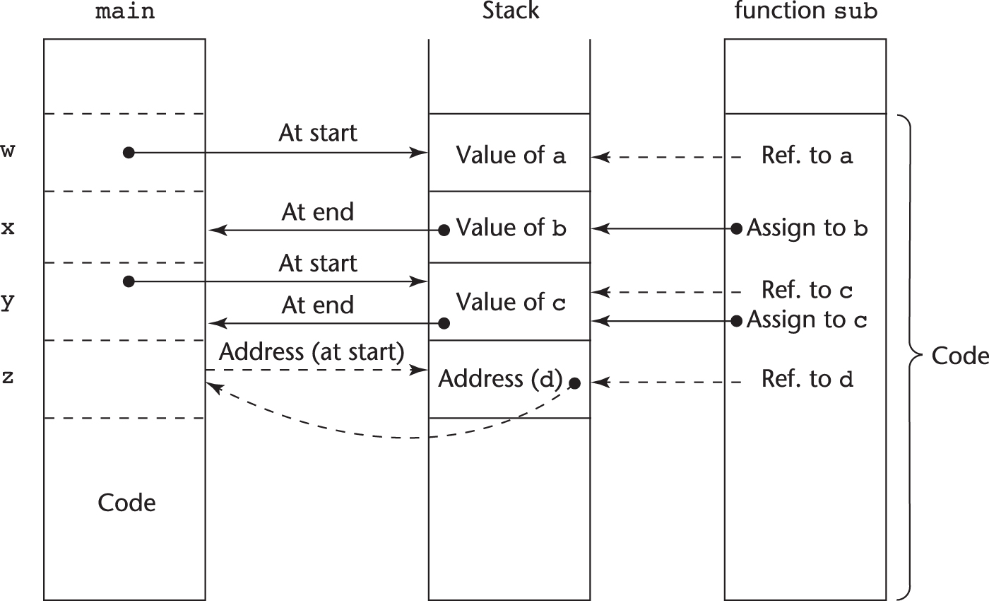
Implementation on Run-time Stack: Example
Function header: void sub(int a, int b, int c, int d)
Function call in main: sub(w, x, y, z)
(assume: pass w by value, x by result, y by value-result, z by reference)

Slide 25
Pass-by-Value (In Mode)
The value of the actual parameter is used to initialize the corresponding formal parameter
implemented by copying (physically moving a value)
Can be implemented by transmitting an access path but not recommended (enforcing write protection is not easy)
Disadvantages (if by physical move): additional storage is required (stored twice) and the actual move can be costly (for large parameters)
Disadvantages (if by access path method): must write-protect in the called subprogram and accesses cost more (indirect addressing)
Popularly used in scenarios where the subprogram is only "using" the parameter for some computation, not changing it

Slide 26
Pass by value: Illustration
modeDemo Item (5) count cost
Main unit (5) total amount (8)
2 separate locations;
value: copy

Slide 27
Pass-by-Result (Out Mode)
When a parameter is passed by result,
no value is transmitted to the subprogram;
formal parameter acts as a local variable with its value transmitted to caller’s actual parameter when control is returned to the caller, by physical move
Potential problems
void sub (x, y ) { //assume x and y are pass-by-result parameters
x = 5; y = 6;
return;
}
sub(p1, p1); whichever formal parameter is copied back will represent the current value of p1
sub(list[a], a); Compute address of list[a] at the beginning of the subprogram or end?
No longer practically used, though variants exist
e.g. C#’s out parameter

Slide 28
Pass by value: Illustration
modeDemo Item count cost (52.0)
Main unit total (52.0) amount (8)
2 separate locations;
value: copy

Slide 29
Pass-by-Value-Result (inout Mode)
A combination of pass-by-value and pass-by-result
Sometimes called pass-by-copy
Disadvantages:
Those of pass-by-result
Those of pass-by-value
Pass-by-reference, another method of inout mode, is more efficient than pass-by-value-result, thus popularly used.

Slide 30
Pass by value-result: Illustration
modeDemo Item count (8) -> (9) cost
Main unit total amount (8) -> (9)
2 separate locations;
value: copy over and copy back

Slide 31
Pass-by-Reference (Inout Mode)
Pass an access path (i.e. address)
Actual parameter and formal parameter shares memory locations, i.e. becomes aliases
Also called pass-by-sharing
Advantage: Passing process is efficient (no copying and no duplicated storage)
Disadvantages
Slower accesses (compared to pass-by-value) to formal parameters
Potentials for unwanted side effects (collisions), e.g.
void fun (x, y) { … } //assume x, y call-by-ref parameters
fun(total, total); fun(list[i], list[j]); fun(list[i], i); //collisions
Efficient and popularly used method
To resolve collision issues: use with caution

Slide 32
The memory address of someValue is copied to value location; thus value is a reference to someValue.

Slide 33
Pass-by-Name (Inout Mode)
By textual substitution
Formals are bound to an access method at the time of the call, but actual binding to a value or address takes place at the time of a reference or assignment
Allows flexibility in late binding, e.g.

Slide 34
Example: Pass-by-name Elegancy
real procedure Sum(j, lo, hi, Ej); //ALGOL 60 program
value lo, hi; //value paramters
integer j, lo, hi; real Ej; //parameter type declaration
begin
real S; //local variable
S := 0;
for j := lo step 1 until hi do
S := S + Ej;
Sum := S
end;
Sum(i, 1, n, x[i]); //x[1]+x[2]+…+x[n]
Sum(i, 1, n, x[i]*y[i]); //x[1]*y[1]+x[2]*y[2]+…+x[n]*y[n]
// in each loop iteration, Ej is re-evaluated as it’s literally substituted by actual parameter

Slide 35
Parameter Passing: Example
//C#
void Method(ref int arg) {
arg = arg + 10;
}
int number = 25;
Method(ref number);
Console.WriteLine(number);

Slide 36
Pass-by-Assignment
Python example
https://medium.com/school-of-code/passing-by-assignment-in-python-7c829a2df10a
my_var = 25
def my_method(v):
v += 10
return
my_method(my_var)
print (my_var)
Pass-by-reference vs. Pass-by-assignment

Slide 37
Note: In Python 25 is an object!
By assignment
After parameter passing
my_var
25
v
Object 25 is immutable!
After v = v + 10
my_var
25
v
35

Slide 38
Pass-by-Assignment
Python example
my_var = [25, 10]
def my_method(v):
v[0] = v[0] + 10
return
my_method(my_var)
print (my_var[0])

Slide 39
Pass-by-Assignment
Python example
my_var = [25, 10]
def my_method(v):
v[0] = v[0] + 10
return
my_method(my_var)
print (my_var[0])
List elements are mutable!

Slide 40
Discussion Questions
What model(s) Java use for parameter passing?
In Java, how to implement parameter passing of a dynamically allocated heap array?
e.g.
public static void f (int [] data) { data[0] = 1; return}
int[] my_data = new int [5];
for (int j = 0; j< 5; j++) my_data[j] = 10;
f(my_data);
//what will be my_data[0] now?
Illustration of above parameter passing?

Slide 41
Parameter Passing Methods of Major Languages
C
Pass-by-value
Pass-by-reference is achieved by using pointers as parameters
C++
Pass-by-value
Pass-by-reference (& parameter)
A special pointer type called reference type is introduced in C++
Java
All non-object parameters are passed are passed by value
So, no method can change any of these parameters
Object parameters are passed by reference via object references
No language supported pass-by-reference method needed.

Slide 42
Parameter Passing Methods of Major Languages (continued)
Fortran 95+ and Ada
Parameters can be declared to be in, out, or inout mode
Actual models (by copy or access path) may vary by implementation
C#
Default method: pass-by-value
Pass-by-reference is specified by preceding both a formal parameter and its actual parameter with ref
out parameter is same as ref except no initial needed.
Python and Ruby
Use pass-by-assignment (all data values are objects);
The actual parameter is assigned to the formal parameter
Mutable and immutable objects play important role
For immutable objects, the actual parameter will not change if formal parameter changes (see example next slide)

Slide 43
Type Checking Parameters
Considered very important for reliability
FORTRAN 77 and original C: none
Pascal and Java: it is always required
ANSI C and C++: choice is made by the user
Prototypes
Relatively new languages Perl, JavaScript, and PHP do not require type checking
In Python and Ruby, variables (i.e. object references) do not have types (objects do), so parameter type checking is not possible

Slide 44
Multidimensional Arrays as Parameters
For most languages arrays are passed by reference
For one-dimensional array, a starting address of the array is passed
The length of the array may not known by the subprogram. That may cause memory leak problem.
C++ example in next slide
If a multidimensional array is passed to a subprogram, the compiler needs to know the size and shape of that array to build the storage mapping function
A starting address and total number of elements not enough
Since a 2-D array is stored linearly in memory, for an array of 16 elements how can you tell if it’s a 4 x 4 array or a 2 x 8 array?

Slide 45
Passing of 1-D array: C++ Example
#include <iostream>
void f(int x[]) {
for (int i=0; i<8; i++)
std::cout << x[i] << " ";
std::cout<<"\n";
return;
}
int main() {
int a[10] ={1,1,1,1,1,1,1,1,1,1};
int b[5] ={1,2,3,4,5};
f(a);
f(b);
return 0;
}
Output:
1 1 1 1 1 1 1 1
1 2 3 4 5 0 -201043027 21990
//by programiz online compiler
//note: in call of f(b), 3 garbage values (0 -201043027 21990) added.

Slide 46
Multidimensional Arrays as Parameters: C and C++
In C/C++ programmer is required to include the declared sizes of all but the first subscript in the formal parameter
e.g. for 3-D array, the 2nd and 3rd dimension must be given in formal parameter
void pass3D (int m3d [][20][30])
Another solution: pass a pointer of the array and the sizes of the dimensions as additional parameters
the user must include in the code the storage mapping function in terms of the size parameters

Slide 47
Multidimensional Arrays as Parameters: Java and C#
Arrays are objects
they are all single-dimensioned, but the elements can be arrays, i.e. multidimensional arrays are represented by array of arrays
Each array inherits a named constant (length in Java, Length in C#) that is set to the length of the array when the array object is created

Slide 48
Design Considerations for Parameter Passing
Two important considerations
Efficiency
One-way or two-way data transfer
But the above considerations are in conflict
Good programming suggest limited access to variables, which means one-way whenever possible
But pass-by-reference is more efficient to pass structures of significant size
Programmer may use a const (constant) array that provides one-way access under pass-by-reference

Slide 49
Parameter Passing: Summary
Three semantic modes of parameter passing: in mode, out mode, and inout mode
The conceptual models of parameter passing
Pass by value
Pass by result
Pass by value-result
Pass by reference
Pass by name
Pass by assignment

Slide 50
Subprogram Names as Parameters
It is sometimes convenient to pass subprogram names as parameters
Very popular in functional programming
Higher order functions, or functional forms
Or, simply function as parameter
Questions to consider
Why we’d have introduce this feature
Language support (syntax) of this feature
Pros and Cons
Which language(s) supporting it, which are not?

Slide 51
Motivation: A sort function in Java
import java.util.Arrays;
int[] arr = { 13, 7, 6, 45, 21, 9, 101, 102 };
Arrays.sort(arr);
What will be the result? i.e. what order will the list be sorted into? Ascending? Descending?
By default: ascending order {6, 7, 9, 13, 21, 45, 101, 102}
What about I want to sort into descending order?
Group Discussion
Java or any other language
Write code

Slide 52
Discussion: A sort function in Java
import java.util.Arrays;
int[] arr = { 13, 7, 6, 45, 21, 9, 101, 102 };
Arrays.sort(arr);
What will be the result? i.e. what order will the list be sorted into? (default: Ascending)
What about I want to sort into a different order?
Arrays.sort(arr, Collections.reverseOrder());
reverseOrder(): a function as parameter
What about I’m sorting an array of objects into various different orders? E.g. score in descending? If same score, name in ascending?
arrS = {(“John”, 89), (“Marv”, 95), (”Jess”, 89), (“Terry”, 92), …}
=> {(“Marv”, 95), (“Terry”, 92”), (“Jess”, 89), (”John”, 89), …}

Slide 53
Function as parameter in sort (pseudo code)
void bubbleSort(int a[], int n, order_fun)
{
int i, j;
for (i = 0; i < n-1; i++)
for (j = 0; j < n-i-1; j++)
if (order_fun(a[j], a[j+1])) //any order you may define
swap(a[j], a[j+1]); //swap two array elements
}
boolean order1 (x, y) { return x < y; } //descending
bubbleSort(arr, 8, order1);
boolean order2 (x, y) {
return (x.score == y.score ? x.name > y.name : x.score < y.score);}
bubbleSort(arrS, Size, order2);

Slide 54
Subprograms as parameters: Applications
Sorting
Sorting in ascending order, descending order
Sorting student objects based on names in ascending order, based on GPA in descending order
Map functions (in map-reduce)
popular in cloud computing, further discussion in Chapter 15
Integration
Integrating sin(x) in [a,b] vs. integrating cos(x), any f(x) in [a,b]?
Same integration method => no need to code again
Can the Integration function take the f(x) as parameter?

Slide 55
Language Support
C/C++: Function Pointer
Can pass a pointer to a function as parameter
Python (and languages in FP paradigm)
Fully support it
def convert (fun, lst) :
result = []
for x in lst :
result = result.append(fun(x))
return result
print(convert(math.factorial, [1,2,3,4]) => [1, 2, 6, 24]
def cube(x): return x**3
print(convert(cube, [1,2,3,4]) => [1, 8, 27, 64]

Slide 56
Subprogram Name as Parameters
Pros and Cons
Pros: previous examples
Cons: see issues below
Issues:
Are parameter types checked?
What is the correct referencing environment for a subprogram that was sent as a parameter?

Slide 57
Subprogram Referencing Environment
The referencing environment indicates the scope and visibility of the local variables
i.e. a subprogram uses a variable x that is not defined inside itself, where should we look for x?
Shallow binding: The environment of the call statement that enacts the passed subprogram - Most natural for dynamic-scoped languages
Deep binding: The environment of the definition of the passed subprogram - Most natural for static-scoped languages
Ad hoc binding: The environment of the call statement that passed the subprogram
Example: next slide

Slide 58
function sub1() { //JavaScript
var x;
function sub2() {
alert(x); // what is x’s value?
};
function sub3() {
var x; x = 3;
sub4(sub2);
};
function sub4(subx) {
var x; x = 4; subx();
};
x = 1;
sub3();
};
Under shallow binding:
x=4
//sub2 called from sub4
Under deep binding:
x=1
//sub2’s static parent is sub1
Under Ad Hoc binding:
x=3
//the environment that //passed sub2 is sub3
//what sub4 called is subx()
//it is inside sub3 that subx() //bound to sub2()
sub1() -> sub3() -> sub4(sub2) ->(subx binds to sub2) -> subx()/sub2() -> x?

Slide 59
Lambda Expressions/functions
Anonymous functions
Popular with AWS
Example (Python)
x = lambda a : a + 10 print(x(5))
More to discuss at functional programming

Slide 60
Overloaded Subprograms
An overloaded subprogram is one that has the same name as another subprogram in the same referencing environment
Every version of an overloaded subprogram has a unique protocol, e.g. C++ examples:
void print (int);
void print (double, char);
int print (Student &, int);
In C++ the return type cannot be used to resolve overloading ambiguities while Ada allows that.
Many languages such as Ada, Java, C++, and C# support subprogram overloading
allow users to write multiple versions of subprograms with the same name
Good for readability
Popularly used in constructors

Slide 61
Discussion: overloaded subprograms
How to resolve ambiguity?
Usually we call a subprogram base on its name
Now, with a number of subprograms with the same name, how to decide which one to call?
Review the subprogram terminology we studied earlier
Which of the following is Java/C++ used to resolve ambiguity?
Protocol, prototype, declaration, definition, …

Slide 62
User-Defined Overloaded Operators
Operators can also be overloaded in many languages including Ada, C++, Python, and Ruby
However, the syntax for overloading a lot different
A Python example
def __add__ (self, second) :
return Complex(self.real + second.real, self.imag + second.imag)
Use: x + y or x.__add__(y) //assume x and y are complex numbers
A C++ Example
class Complex {
friend Complex operator+(Complex a, Complex b) { … }
…
};
Use: Complex x, y, z; …; z = x+y;
Question: Does Java support overloaded operators? Why or why not?

Slide 63
Generic Subprograms
A generic or polymorphic subprogram takes parameters of different types on different activations
Overloaded subprograms provide ad hoc polymorphism
In OOP, polymorphism usually refers to subtype polymorphism where a variable of type T can access any object of type T as well as any type derived from T
A subprogram that takes a generic parameter that is used in a type expression that describes the type of the parameters of the subprogram provides parametric polymorphism - A cheap compile-time substitute for dynamic binding

Slide 64
Generic Subprograms in C++
C++
Generic subprograms are preceded by a template clause that lists the generic variables, which can be type names or class names
“real” versions of a generic subprogram are created implicitly when the subprogram is called
template <typename Type> //<class Type> may also be used
Type max(Type first, Type second) {
return first > second ? first : second;
}
int a=5, b=3, c;
c = max(a, b); //Type is unified with int
double x = 3.5, y=1.5, z;
z = max(x,y); //Type is unified with double

Slide 65
Generic Subprograms in Java
Generic subprograms introduced in Java since Java 5.0
Example:
public static <T> T doIt(T[] list) { … }
T is the name of the generic type
The parameter list is an array of generic elements
- A call below bounds String to T
doIt<String>(myList);
The generic type must be of a class that implements the Comparable interface

Slide 66
Generic Subprograms in Java (continued)
Wildcard types
Collection<?> is a wildcard type for collection classes
void printCollection(Collection<?> c) {
for (Object e: c) {
System.out.println(e);
}
}
- Works for any collection class
Question: Generics in Java vs. that in C++? Which one has better design?
Discussion: Write a generic sort method in Java (header only) and two calls to sort an array integers, an array of (name, score) objects.

Slide 67
Summary
A subprogram definition describes the actions represented by the subprogram
Subprograms can be either functions or procedures
Three modes of parameter passing: in mode, out mode, and inout mode popularly implemented as call by value, and call by reference
Some languages allow subprogram as parameters
Referencing environment varies in this case
Subprograms can be overloaded and some languages even allow operator overloading
Subprograms can be generic

